Slide 1
Poor orthodontic outcomes and incorrect treatment plans
Dr.Faegheh Gholinia

Slide 3
Orthodontic treatment
Complicated
Comprehensive
Quality of life
Long term
Case dependant

Slide 6
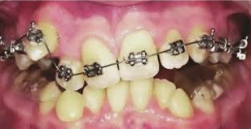

Slide 10
Why failure?
Human source
Appliance source
Material source
Timing source

Slide 11
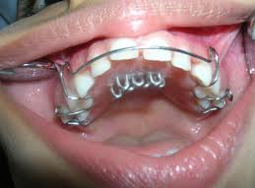

Slide 14
Clinician’s failure
Diagnosis
Treatment planning
Clinical practice
Managing

Slide 16
Diagnosis failure
Communication
History
Clinical evaluation
Records(order and analysis)
Problem list
Cost , risk/benefit
Informed consent

Slide 18
Poor patient compliance
Appliance wear
Oral hygine
Attend the appointment
Retention
Debond

Slide 24
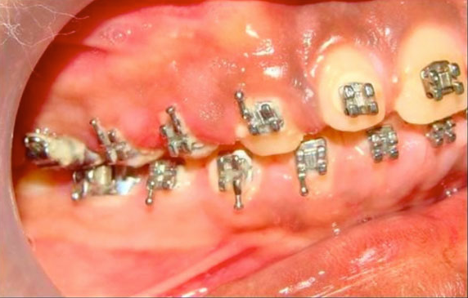

Slide 25
Treatment planning in orthodontics
Problem list is competent
Patient’s preferences
Clinician’s ability
Treatment goals is clear
Well defined treatment protocol
biomechanics
alternatives

Slide 32
treatment plan failure
Extraction
Midline
Profile
Gumminess
Root torque
Bite depth
No surgery
Impaction
Mucogingiva
Dental or skeletal
3D plans

Slide 34
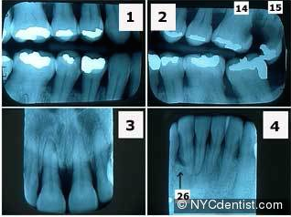

Slide 40
Specialist versus general practitioner
Knowledge
Experience
focus
Attitude
concept

Slide 46
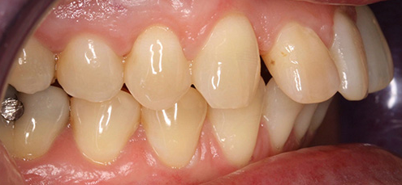

Slide 47
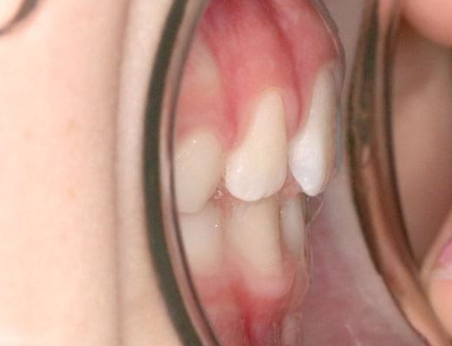

Slide 48
Relapse
Poor treatment protocol
Poor compliance
Wrong retainer selection
Growth and changes

Slide 49
